Slide 1
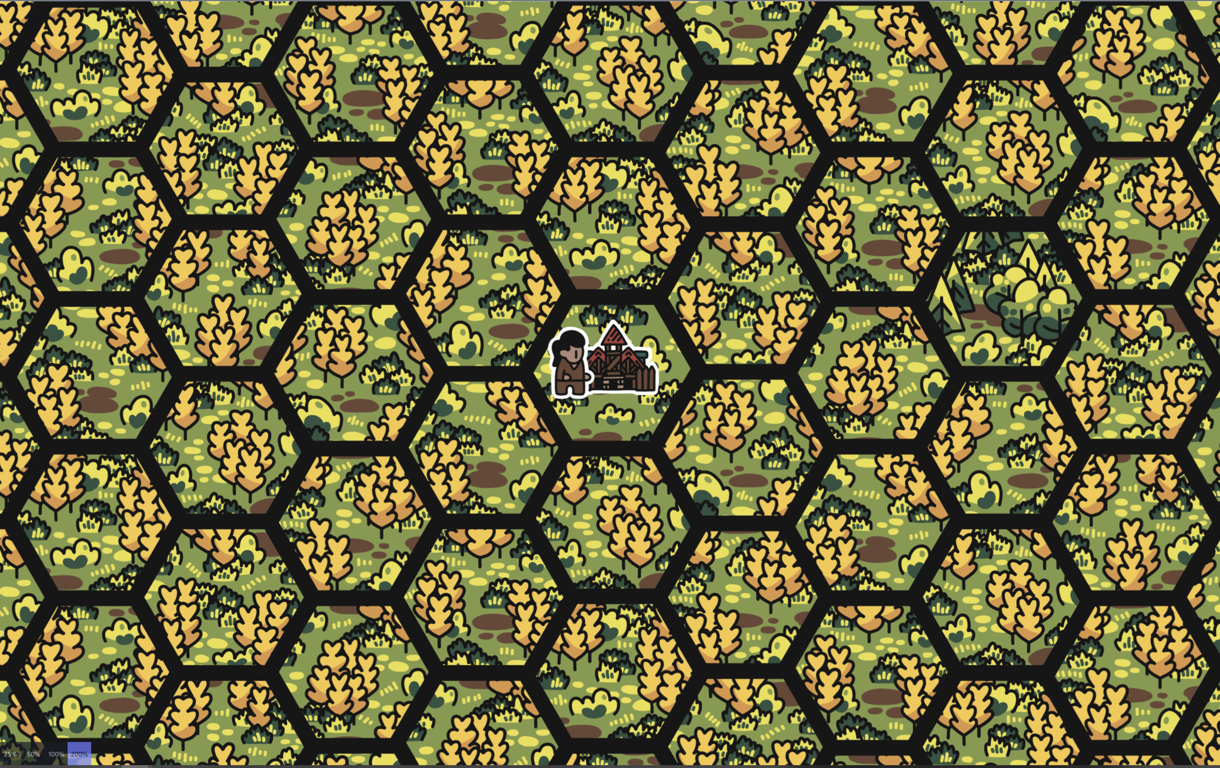

Slide 3
Buildings - Storage
Farm
Costs: 50 grain
Limit: 100 max
Windmill
Costs: 100 grain, 50 wood
Limit: 250 max
Quarry
Costs: 200 grain, 100 wood, 50 stone
Limit: 500 max
Storage
Costs: 500 grain, 500 wood, 300 stone, 100 steel
Limit: 2x
Multiple but Cost doubles

Slide 4
Buildings - Exploration
Tower
Costs: 100 wood
Expansion 1
Lighthouse
Costs: 200 grain, 200 wood, 100 stone
Expansion 2

Slide 5
Buildings - Special
Barracks
Costs: 100 wood
Unlocks crafting
Sanctuary
Costs: 100 wood, 200 stone
Unlocks looting dead enemies
(Some items can only be looted)

Slide 6
Buildings - Players
Tent
Costs: 50 grain, 20 wood
Gain: 1 Peasant
House
Costs: 100 grain, 50 wood, 20 stone
Gain: 1 Worker
City House
Costs: 200 grain, 100 wood,
150 stone, 20 steel
Gain: 1 Elite

Slide 7
Buildings – Defense
Ballista
Costs: 100 wood, 50 stone, 60 steel
Stats: 3 range, 12 strength, 6 damage, 5 pierce
Trebuchet
Costs: 100 wood, 100 stone, 30 steel
Stats: 6 range, 8 strength, 4 damage

Slide 8
Attackers
Hunters
Will only attack your active players
Raiders
Will attack your base and any players who get in their way
Appear periodically
Stronger over time (5 Levels)

Slide 9
Players
Default
1 Command, 30 Health, 2 Speed, 15 Strength, 0 Defense
Peasant
1 Command, 20 Health, 1 Speed, 5-15 Strength, 0 Defense
Worker
3 Commands, 50 Health, 2 Speed, 10-20 Strength, 5-10 Defense
Elite
5 Commands, 100 Health, 3 Speed, 20-30 Strength, 10-15 Defense

Slide 10
Player - Combat Behaviour
What the player does when attacked
Ignore
Does nothing
Flee
Drops all commands and returns home
Fight
Adds a kill command against the attacker

Slide 11
Game Controls
‘game stop’ – Pauses the game
‘game start’ – Resumes the game
‘game reset’ – Resets the game to an initial paused state

Slide 12
Timer Controls
‘timer x’- where x is the round time in SECONDS!!! NOT MILLISECONDS
Example: ‘timer 5’ = 5 second rounds

Slide 13
Build Controls
‘build name’ – Build the specified building
Some buildings can only be built once

Slide 14
Craft Controls
‘craft name’ – Craft the specified item

Slide 15
Player Controls - Special
‘player name rename newname’ – Rename a player, needs to be unique
‘player name equip itemname’ – Equip item on player, unequips current item of same category
‘player name unequip’ – Unequip all items from player
‘player name send’ – Sends the player out with their current configuration

Slide 16
Player Commands
Collect
‘player x collect grain’
Collect specified resource grain/wood/stone/steel
Player collects until their bag is full or the no resource found
Attack
‘player x attack y’ or ‘player x attack’
Attack the specified target (or nearest) once
Kill
‘player x kill y’ or ‘player x kill’
Kill the specified target (or nearest one)
If target is not found command is canceled
Rest
‘player x rest’
Player returns home if not already home
Heals for 20% of Max Health

Slide 17
Stats
Strength
Scales how much damage you deal and your carry limit
Defense
Percentage of damage reduction
Speed
Tiles moved per round
Damage
Determines damage scaling
AttackSpeed
How many attacks per round (min 1)
AttackRange
Distance to attack from
Pierce
Flat damage added after defense reduction
Block
Reduces incoming pierce damage
GrainModifier WoodModifier StoneModifier SteelModifier
Multiplier on resource pickup

Slide 18
Damage Calculation
(Tip: weapons are needed to apply strength scaling! Without it you only deal 1 damage)
Example:
Attacker: 14 strength, 4 damage, 5 pierce
Target: 10 defense, 3 block
Damage scaling is applied by how much the damage fits inside your strength = floor(strength / damage)
Damage scaling is reduced each time it is applied
14 - 4 => 4 damage
14 – 8 => 3 damage
14 – 12 => 2 damage
Total 9 damage
Reduced damage = scaled damage - scaled damage * (defense / 100))
Pierce damage (min 0) = pierce – block
Final damage = reduced damage + pierce damage

Slide 19
Item categories
Each player can equip:
1 Main (Tools/Weapons)
1 Additional
1 Head
1 Body
1 Hands
1 Legs
1 Feet

Slide 20
Items – Tools
Name | Stats | Cost
sickle | +100% grain gained | 100 grain
axe | +100% wood gained | 100 wood, 50 stone, 20 steel
pickaxe | +100% stone & steel gained | 50 wood, 50 steel
scythe | +200% grain gained | 200 grain, 50 wood, 50 steel

Slide 21
Items – Weapons (Melee)
Name | Stats | Cost
dagger | 4 damage, 2 attackspeed, 3 pierce | 30 wood
sword | 8 damage, 2 pierce | 30 wood
hammer | 12 damage | 30 stone
spear | 5 damage, 5 pierce | 20 wood, 5 steel
sword_of_bleeding | 15 damage, 10 pierce, 2x damage raken | not craftable – loot only

Slide 22
Items – Weapons (Ranged)
Name | Stats | Cost
sling | 3 damage, 2 range | 30 grain
shortbow | 5 damage, 2 pierce, 3 range | 50 wood
longbow | 10 damage, 6 range | 50 wood
crossbow | 10 damage, 5 pierce, 4 range | 40 steel

Slide 23
Items - Additional
Name | Stats | Cost
wooden_shield | 10 defense, 5 block | 50 wood
iron_shield | 20 defense, 10 block | 30 steel

Slide 24
Items – Additional (Non-craftable)
Name | Stats | Cost
cloack_of_protection | 40 defense, 5 block | not craftable – loot only
bottomless_bag | +200% carry limit | not craftable – loot only
ring_of_speed | 3 speed, 2 attackspeed | not craftable – loot only
belt_of_strength | 50 strength | not craftable – loot only
horse | 2 speed, +100% carry limit | not craftable – loot only

Slide 25
Items - Basic
Name | Stats | Cost
basic_cap | 3 strength | 30 grain
basic_robe | 5 defense | 50 grain
basic_gloves | 2 block | 20 grain
basic_pants | 5 defense | 50 grain
basic_shoes | 5 defense | 20 grain

Slide 26
Items - Leather
Name | Stats | Cost
leather_helmet | 5 strength | 30 wood
leather_armor | 10 defense | 50 wood
leather_gloves | 10 block | 20 wood
leather_pants | 3 block | 50 wood
leather_boots | 10 defense, 1 speed | 20 wood

Slide 27
Items - Plate
Name | Stats | Cost
plate_helmet | 10 strength, 3 block | 30 steel
plate_armor | 30 defense | 50 steel
plate_gloves | 5 block | 20 steel
plate_pants | 20 defense, 5 block | 50 steel
plate_boots | 10 defense, 3 block, 1 speed | 20 steel

